Slide 1
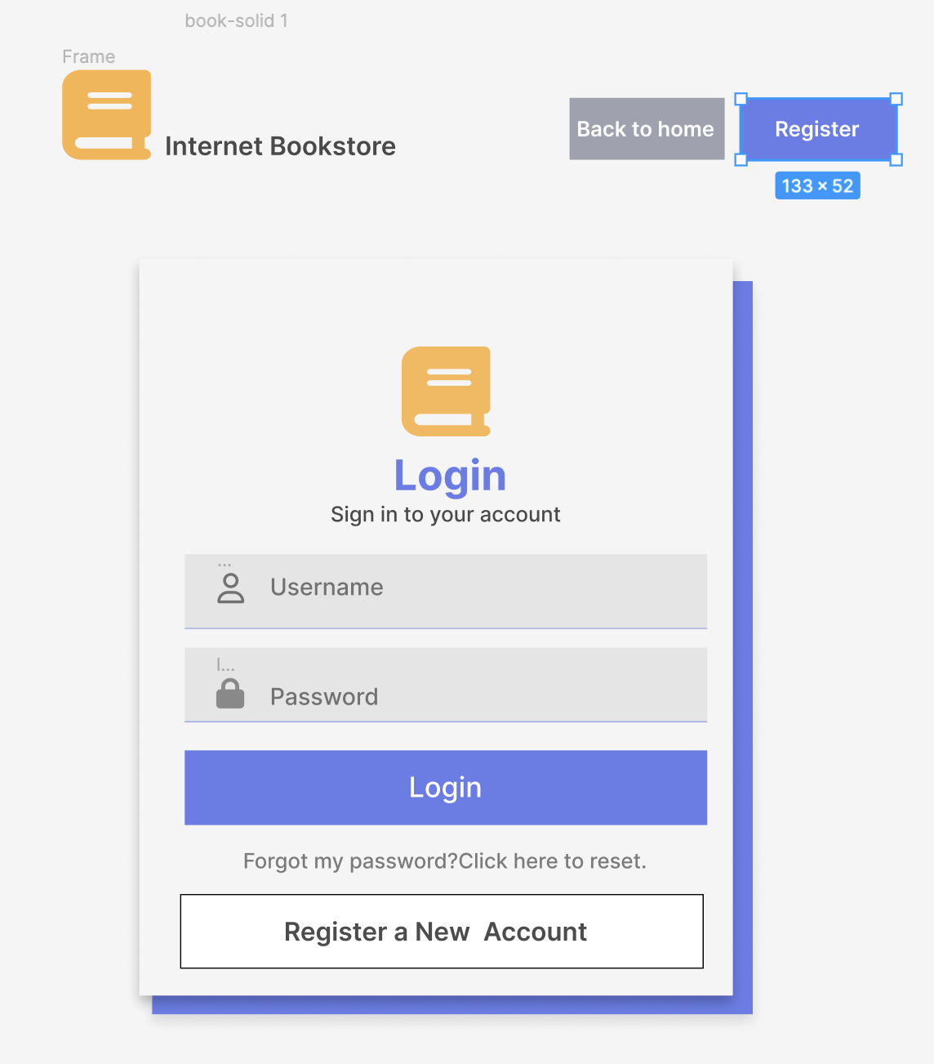
Login
The system displays the Login Page.

Slide 2
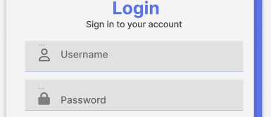
The Customer types his or her Username and Password

Slide 3
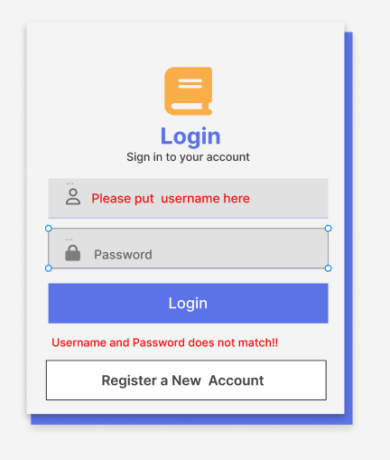
The system ensures that the Customer has provided valid data (correct username and password).Then the system returns the Customer to the Home Page . Otherwise will have alert message

Slide 4
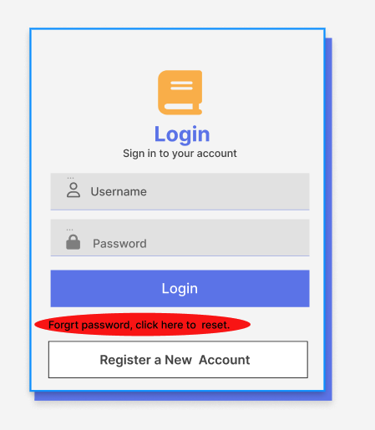
If the user forgot password, the user can click the link down below to reset the password

Slide 5
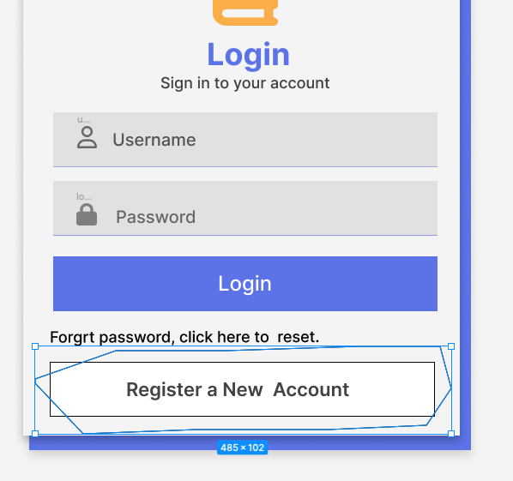
If the user doesn’t have an account or want to create a new account, there is a button down the bottom for user to register for a new account, which will take user to sign up page.

